Slide 1

A Project Review Meeting on Multi City Trip Planner
By
Pranav 2520030207
Yaswanth 2520090095
Team Number: 26
Under the guidance of
Dr. N. Nirmala Jyothi
Associate Professor
Department of Computer Science and Engineering
Koneru Lakshmaiah Education Foundation (Deemed to be University estd. u/s. 3 of the UGC Act, 1956) Off-Campus: Bachupally-Gandimaisamma Road, Bowrampet, Hyderabad, Telangana - 500 043. Phone No: 7815926816, www.klh.edu.in

Slide 2
Outline of the Presentation
Abstract
Introduction
Problem Statement
Project Flow Diagram
Objectives with Justification
Modules[Frontend web pages]
Expected Outcomes of the Proposed Work
Conclusion
References

Slide 3
Abstract
TripForge is a web-based multi-city trip planner designed to simplify travel planning for users who want to visit multiple destinations in a single journey. The platform helps users organize routes, manage budgets, create itineraries, and explore travel options efficiently. By combining all travel-related planning features into one system, TripForge provides a seamless and user-friendly experience.

Slide 4
Introduction
Planning trips across multiple cities can be difficult and time-consuming. Travelers often use different websites and applications for booking, route planning, budgeting, and itinerary management. This creates confusion and increases the chances of errors. TripForge solves this problem by offering a centralized platform where users can plan their complete journey easily and effectively.

Slide 5
Problem Statement
Most existing travel planning systems focus mainly on single-destination trips and do not provide proper support for multi-city travel. Users face several challenges such as:
Difficulty in route optimization
Managing travel expenses
Scheduling conflicts
Handling multiple bookings
Lack of centralized travel management
TripForge aims to overcome these challenges by providing an all-in-one multi-city trip planning solution.

Slide 6
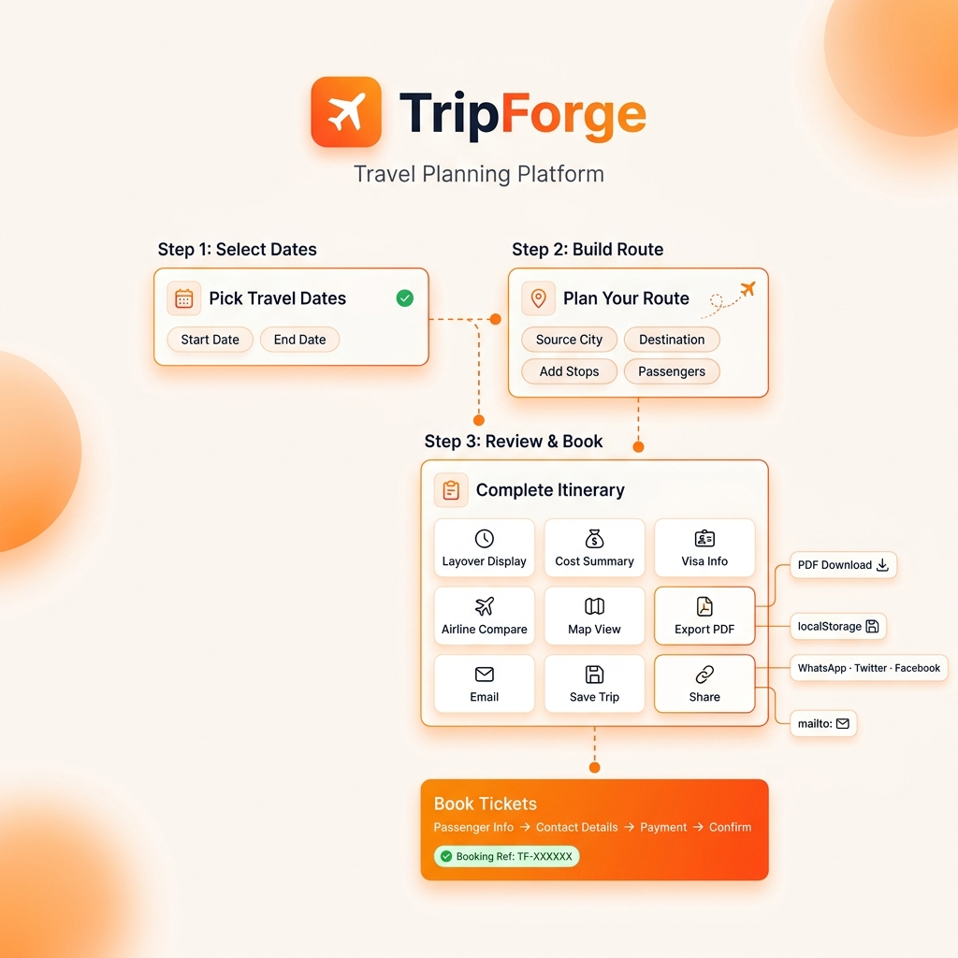
Project Flow Diagram

Slide 7
CO WISE MAPPING
CO1: Front-End Architecture & UI Engineering
Component Architecture: Reusable UI blocks like PaxCounter and CitySearch for modular design.
Layout Constraints: Responsive interfaces built with flexible CSS grids and adaptive styling.
CO2: ES6+ JavaScript Patterns
ES6+ Array Pipelines: Advanced data filtering, mapping, and reduction for route calculations.
Algorithmic Geolocation: Haversine distance math and parabolic geodesic flight coordinate calculations. CO3: React Fundamentals & Hooks
Hooks-Based State Flow: Dynamic props sharing and state tracking using useState and useRef.
Lifecycle Management: useEffect hooks for automatic currency detection and Leaflet Map updates.
CO4: State Management & Architecture
Lifting State: Centralized user choices inside
App.jsx to keep multiple step components synchronized.
Browser Persistence: Secure local sessions and booking records saved in Session and Local Storage.
CO5: Routing, Validation & Optimization
Custom Step Routing: State-controlled page transitions utilizing custom CSS plane animations.
Code Splitting: Strict form input validation and dynamic async loading for PDF export scripts.
CO6: Production Readiness & Build Tools
Vite Integration: Modern build config supporting instant hot updates and JSX compiler settings.
Production Bundling: Automatic compilation of optimized, minified assets into deployment folders.

Slide 8
Objectives with Justification
Objectives
To simplify multi-city travel planning
To reduce manual effort in itinerary creation
To provide accurate budget estimation
To improve travel convenience and management
To deliver a user-friendly web experience
Justification
Travelers require a smart and efficient platform to manage complex journeys. TripForge reduces planning time, minimizes confusion, and helps users organize their trips more effectively.

Slide 9
Modules [Frontend web pages]
Login & Signup Page: We have LoginPage.jsx for user authentication.
Destination Planner: This is our Step 1 & Step 2 where users select dates and build their route (source, destination, stops).
Budget Calculator: This is the Cost Summary module in Step 3, which calculates flights, hotels, and daily expenses.
Itinerary Dashboard: This is the main Step 3 Review Dashboard showing layovers, maps, airlines, etc.
Booking & Confirmation Page: This is the "Book Tickets" modal we just added in Step 3 that takes passenger info, payment, and gives a confirmation reference.

Slide 10
Expected Outcomes of the Proposed Work
Faster and smarter travel planning
Better route optimization
Improved budget management
Enhanced user satisfaction
Centralized management of travel activities
Scalable platform for future improvements

Slide 11
Conclusion and Future Scope
Conclusion
TripForge – Multi City Trip Planner is an efficient and user-friendly web application designed to simplify travel planning across multiple destinations. The system helps users organize routes, manage budgets, create itineraries, and handle travel details in one centralized platform. By reducing manual effort and improving travel management, TripForge enhances the overall travel experience for users. The project demonstrates how modern web technologies can provide smart and convenient solutions for complex travel planning.
Future Scope
The future scope of TripForge includes several advanced features and improvements that can make the platform more intelligent and user-friendly.
Integration of AI-based travel recommendations for personalized trip planning.
Real-time weather updates and traffic information.
Online booking facilities for hotels, flights, and transportation.
GPS and live navigation support for travelers.
Mobile application development for Android and iOS platforms.
Multi-language support for international users.
Chatbot assistance for instant customer support.

Slide 12
References
React.js Official Documentation
Node.js Documentation
Travel and Tourism Research Papers
UI/UX Design Resources
Travel API Documentation
Web Development Tutorials and Guides

Slide 13
Thank you

